Slide 1
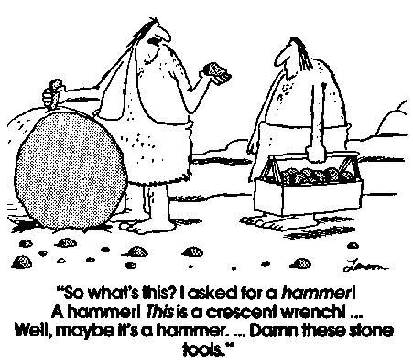
TOOLS

Slide 2
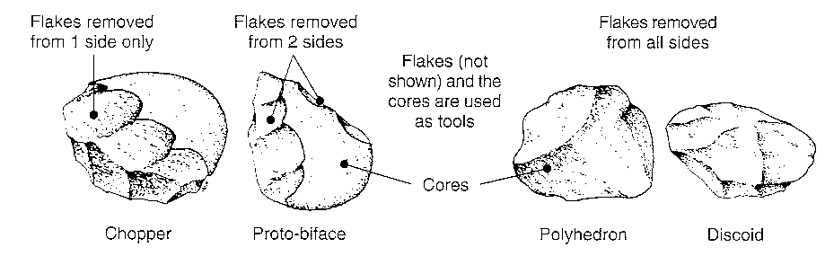
Oldowan (pebble) tool culture
Probably made by Homo habilis, these tools were simple river-worn pebbles that were crudely fashioned with a minimum of flakes being removed. These tools typically had flakes knocked from several angles to produce a core with a cutting edge (e.g. chopper, discoid, polyhedron). Although the cores may have been used as tools, it is known that the sharp flakes were also useful in cutting.

Slide 3
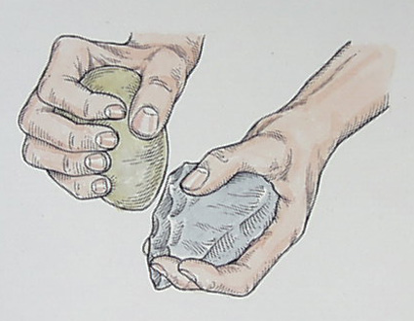

Slide 4
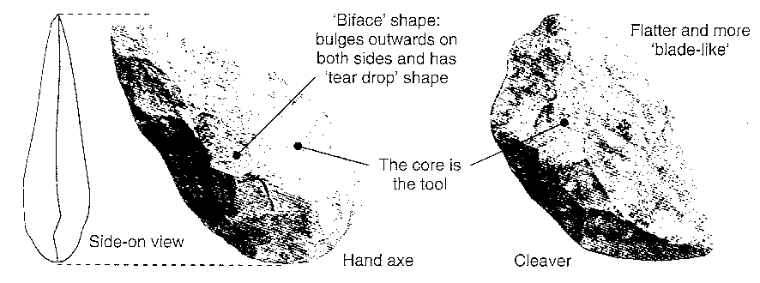
Acheulian tool culture
The product of Homo erectus and archaic Homo sapiens, these tools were typically tear drop in shape and were carefully crafted with a slight bulge on each broad surface (called a bi-face). They ranged greatly in their size and are often referred to as hand axes although it is not clearly understood how they were used. They differ markedly from the earlier pebble tools in that there appears to be a standard design and each tool is manufactured using a great many more blows to remove flakes.

Slide 5
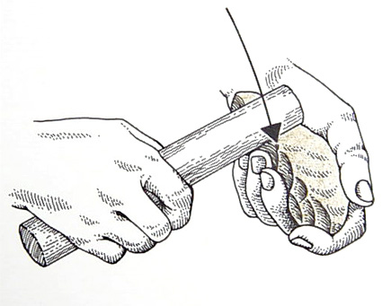

Slide 6
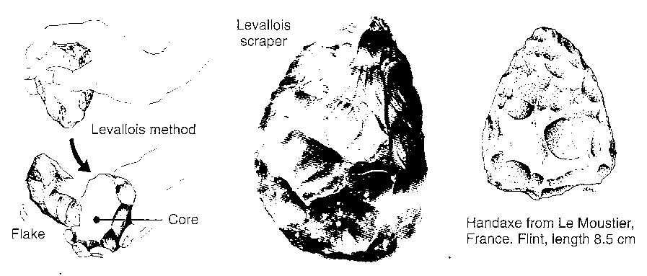
Mousterian tool culture
The Neanderthals developed a more refined tool culture than the earlier Acheulian. Flint finally became a sought after material to produce stone tools, The advantage of this rock was the very predictable way in which it would chip when struck with another hard object. Much finer workmanship was possible. A particular tool making technique from this period is known as the Levallois method, It involves the preparation of a core and striking off a large oval flake which is then retouched on one surface only (see the photograph - the retouched surface is visible).

Slide 7
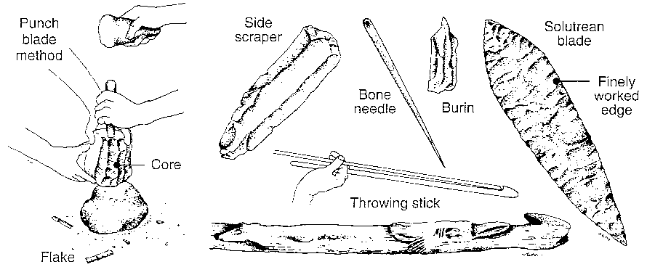
Upper Palaeolithic tool culture
  There was a rather sudden increase in the sophistication of tool making about 35000 to 40 000 years ago. Both the modern Homo sapiens and the last of the Neanderthals produced flint fools of much finer workmanship using a technique called punch blade. Long, thin flakes are removed and shaped into a large number of different tool types. European sub-cultures (traditions) include the Magdelanian, Solutrean and Aurignacian. Other material such as bone, ivory and antler became increasingly utilised to produce very fine tools such as needles.

Slide 8
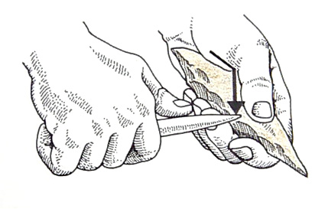

Slide 9
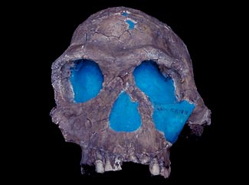
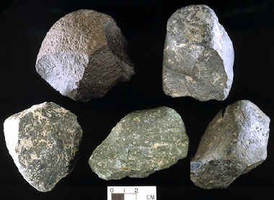
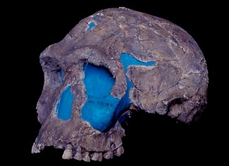
Archaeological Evidence: Oldowan tool tradition
2.5 to 1.5 million year ago
OLDOWAN CHOPPER CORE
OLDUVAI GORGE, TANZANIA AFRICA
UNIVERSITY OF CALIFORNIA--BERKELEY, DEPT. OF ANTHROPOLOGY COLLECTION
KNM ER 1813
Notes:
The ER 1813 fossil is somewhat skewed on its left side, a result of the pressures the skull experienced during the fossilization process. ER 1813 had a cranial capacity of only 510cc, well below the 600cc cutoff that had been in place since the creation of the Homo habilis species name.

Slide 10
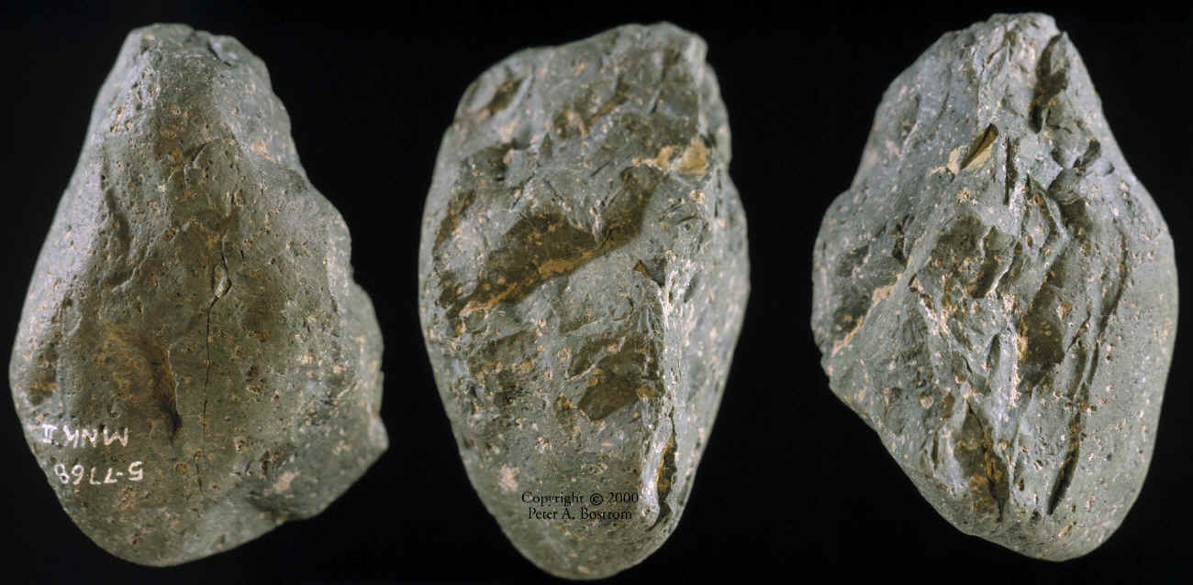
OLDOWAN CHOPPER CORE
OLDUVAI GORGE, TANZANIA AFRICA
UNIVERSITY OF CALIFORNIA--BERKELEY, DEPT. OF ANTHROPOLOGY COLLECTION

Slide 11
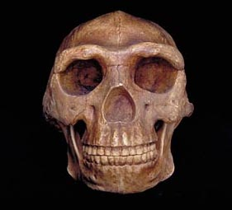
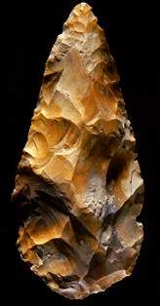
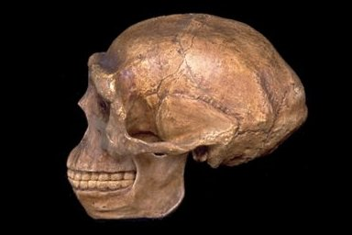
Archaeological Evidence: Acheulean Tool Tradition
1.5 million years ago, to about 200 000 years ago
Acheulean hand ax
Homo erectus
Notes:
The Acheulean tradition appears to have replaced the Oldowan tradition, and specimens believed to belong to this tradition date from 1.5 million years ago, to about 200 000 years ago. It is generally accepted that these tools were used by Homo erectus. Specimens have been found in Kenya, Tanzania, Zambia, South Africa and Europe. The name 'Acheulean' comes from St Acheul, in northern France, where the first tools of this kind were found.

Slide 12

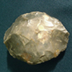
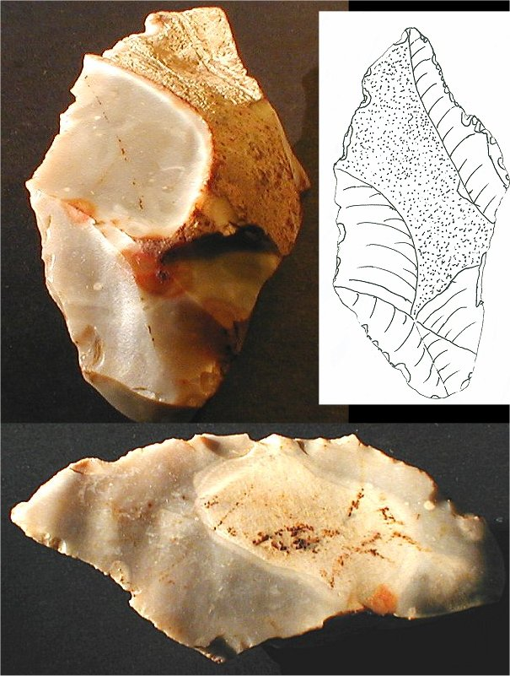
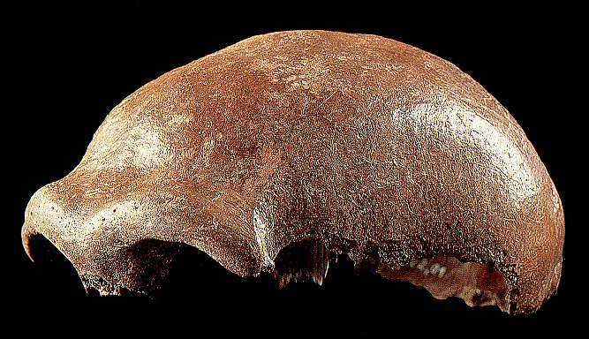
Mousterian France:100,000 to 40,000 years ago
Homo neanderthalensis or Homo sapien neanderthalensis
Notes:
Mousterian France:100,000 to 40,000 years ago
The Mousterian is generally associated with the Neanderthals. Hand-axes continue to be common, but are more finely worked. Scrapers, blades and other tools also show far better craftsmanship.

Slide 13
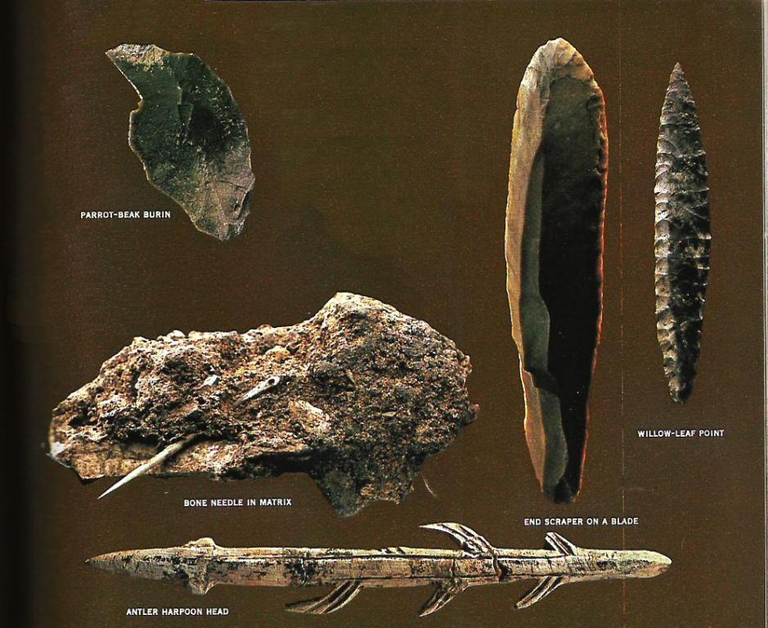
Upper Paleolithic

Slide 14
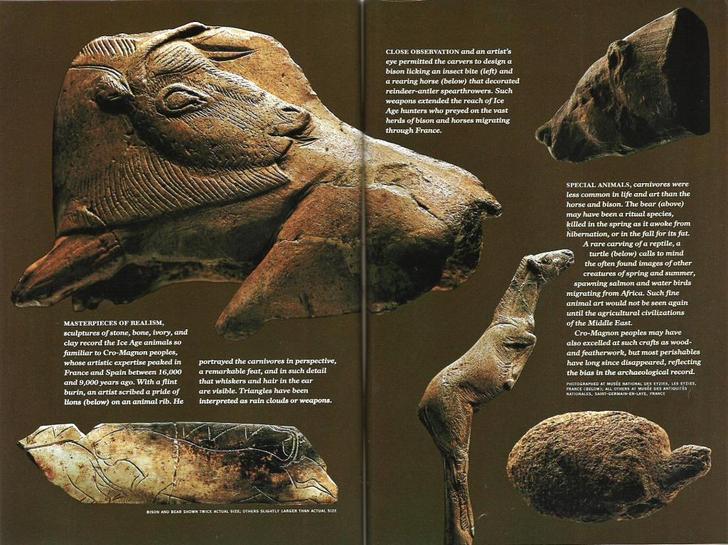

Slide 15
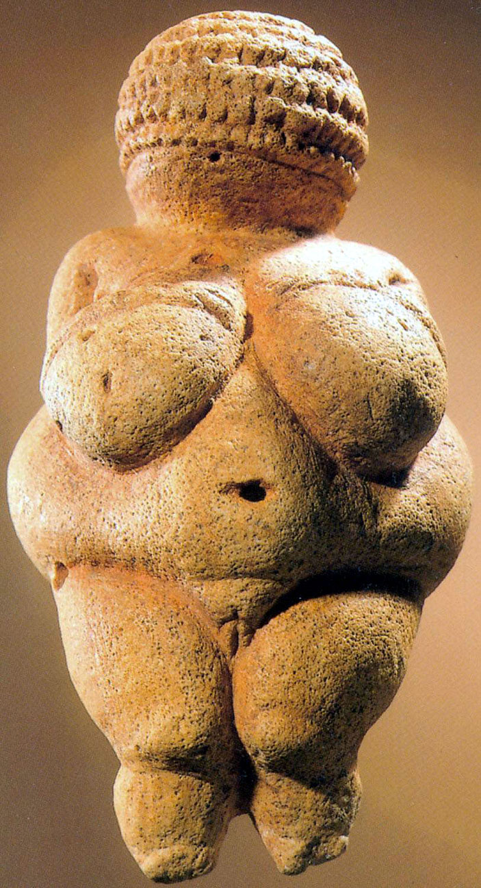
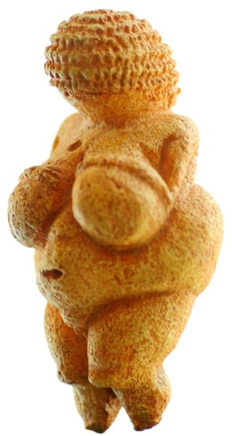
Venus of Willendorf, from Austria. c. 25,000 - 20,000 BCE Limestone, 11.1 cm. Naturhistorischesmuseum, Vienna
Statuettes like this are one of the earliest form of art and with their exaggerated female characteristics are thought to be fertility symbols.

Slide 16
Hunter-Gatherers
Before about 10,000 years ago humans went about in fairly small groups.
Men would go out and hunt larger game
Women would collect roots, berries, fruits and grains
Many groups would be nomadic – move around from season to season
Some would follow herds of animals

Slide 17
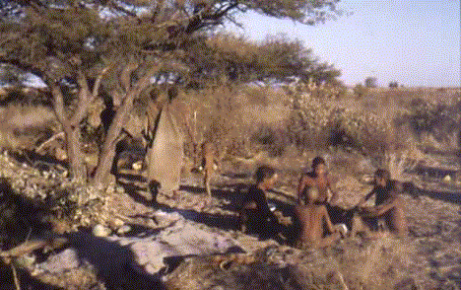
Kung bushmen – Sth Africa

Slide 18
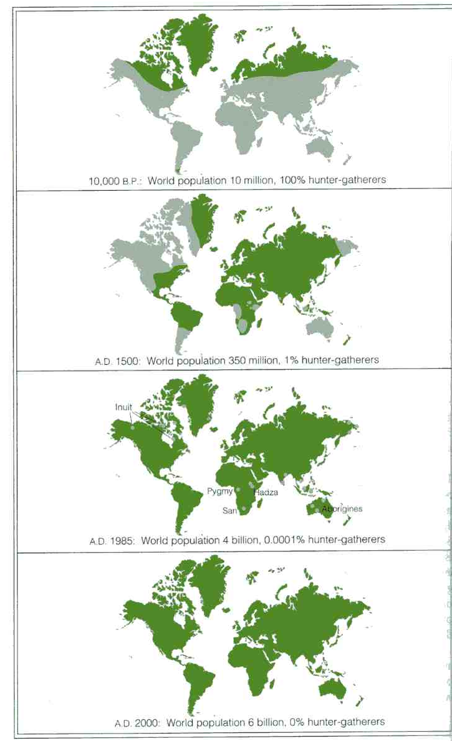
99% of history
From Price & Feinman (2001)
Grey areas show where hunter-gatherers live at each time surveyed.
NB both uninhabitable areas and areas inhabited by non-hunter-gatherers (farming and industrial societies) are shown in green.

Slide 19
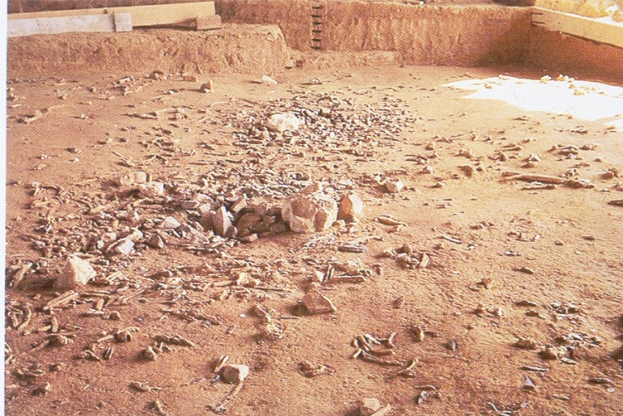
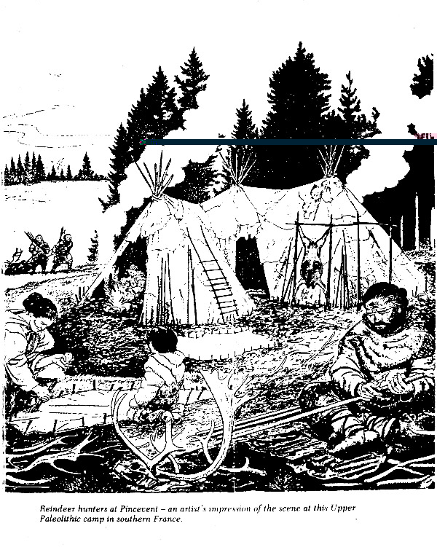
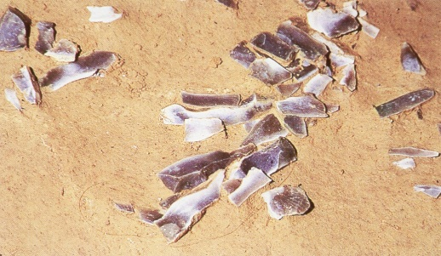
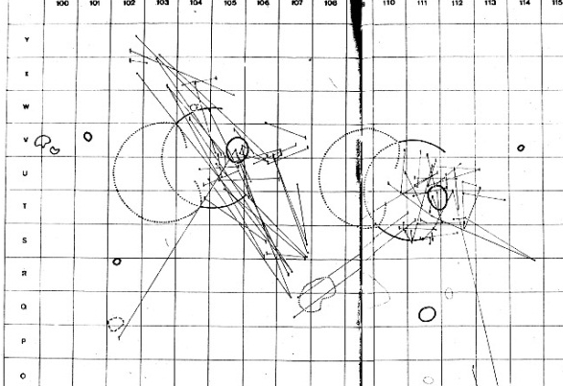
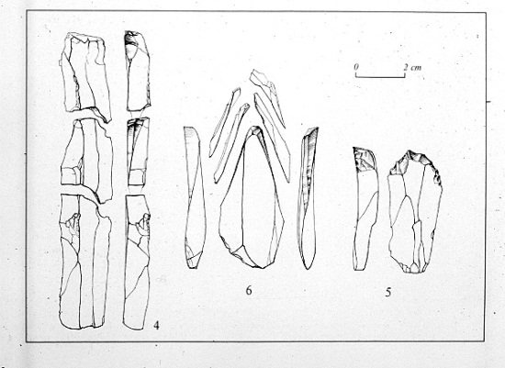
Pincevent – Magdalenian reindeer hunters c. 12,300bp
The site at Pincevent is well-preserved because it was covered by fine silts and sands from the river Seine. Careful excavation (left) has revealed a number of episodes of camps at the site – these have hearths (centre of the picture) and a pattern of debris which suggests the use of tents (see reconstruction below). Refitting of stone tools (below left) tells us about use and discard and some sharing (not shown) of tools amongst people
around different
hearths.

Slide 20
Agriculture
About 10,000 years ago (8000 BC) people started to settle down in villages and grow crops and domesticate animals.
This allowed them to produce excess food, start to trade, start to specialise more in skills such as pottery, weaving, art and more.
It did leave them vulnerable to setbacks such as damage to food crops and spread of disease

Slide 21
Contrasts between hunter-gatherers and farmers
Hunter-gatherers
Mobile (very few possessions)
Economy based on wild resources (social
storage as a strategy for dealing with “bad
years”)
Low population density (long birth interval –
prolonged lactation; little population
growth)
Overall stability
Relatively little impact on environment
(use of fire to clear small areas)
Sparse archaeological record
(campsites, rock shelters, debitage
scatters)
Farmers
Sedentary (some accumulation of
possessions, esp. pottery, in permanent
dwellings)
Economy based on domesticated crops
and animals (seed crops readily stored)
High population density (short birth
interval – weaning foods; population
growth)
Expansion necessary
Clearance of land for arable farming;
impact of livestock (use of ground
stone axes and fire in clearance)
Archaeological imprint on landscape
(settlements, boundaries, monuments)

Slide 22
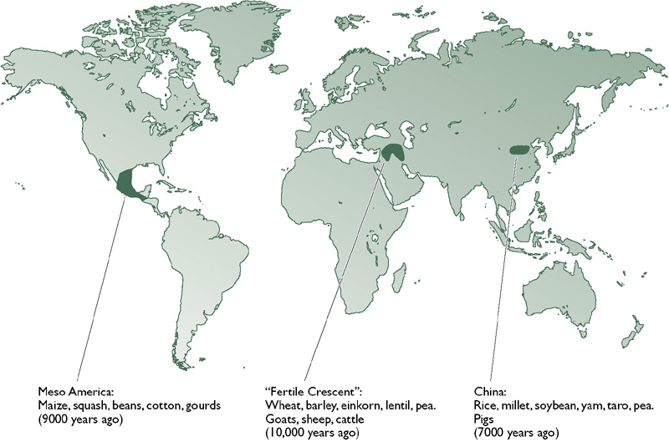
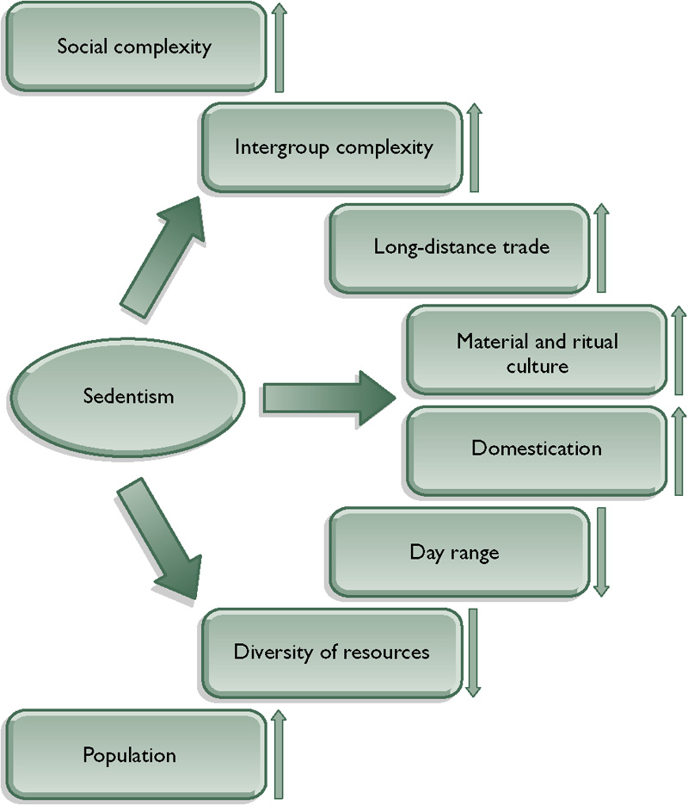
Origins of farming
Farming started independently in a number of areas – the three shown here are the best known
The effects of settling down – and starting to far – were many and various and have led to the world as we know it.
Figures from Lewin & Foley (2003)

Slide 23
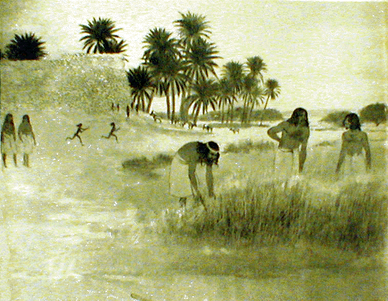
Harvesting scene outside the walls of Jericho about 9000 b.p. Inside we can see the watch -tower or Migdal. The men are using antler or wooden sickles with flint blades for reaping the wheat [Einkorn]. Women are on their way to assist in the harvesting. The goats are semi-domesticated, the field is irrigated by a ditch from a spring.

Slide 24
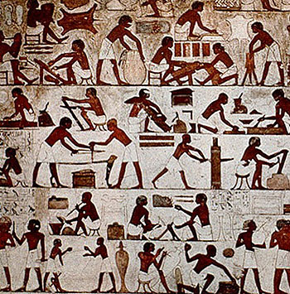
Specialisation

Slide 25
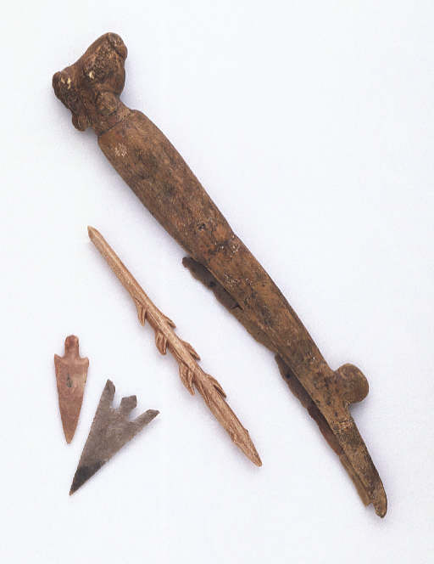
Sickle
Harpoon
Flint arrowheads

Slide 26
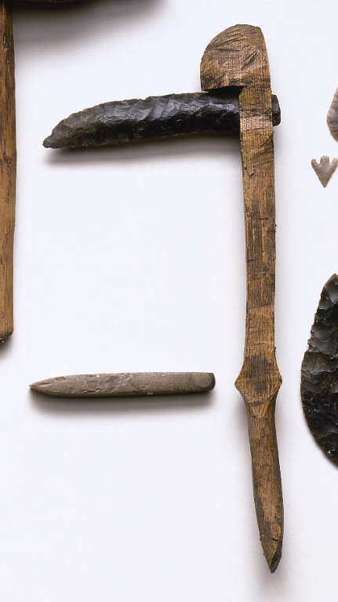

Slide 27
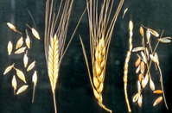
Wheat

Slide 28
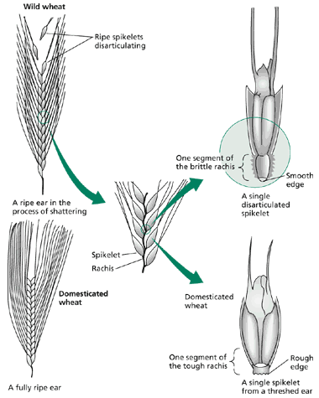
Plant domestication – changes in dispersal mechanisms for the seed
Wild versus domesticated forms of einkorn wheat.
The spikelets of the wild variety abscise readily from the ripened head at abscission zones located nearby on the rachis, leaving a smooth abscission scar on the disarticulated spikelet.
In contrast, the abscission zones of the domesticated varieties that have tough rachises fail to develop properly, and the spikelets remain on the head until released by threshing.
Note that the breakage of the rachis below the spikelet leaves a rough edge, which tends to impede penetration into the ground.
Plant Physiology Online: Abscission and the Dawn of Agriculture
http://www.plantphys.net/article.php?ch=22&id=222

Slide 29
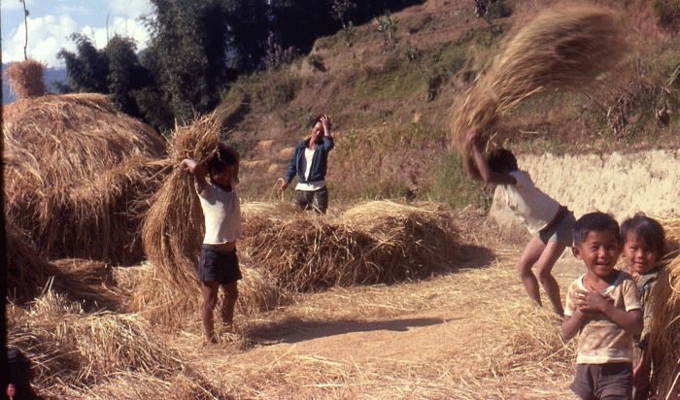
Threshing wheat
O.K. its not stone age but some things never change.

Slide 30
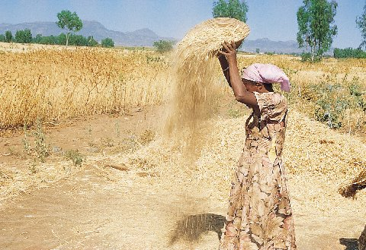
Winnowing threshed wheat

Slide 31
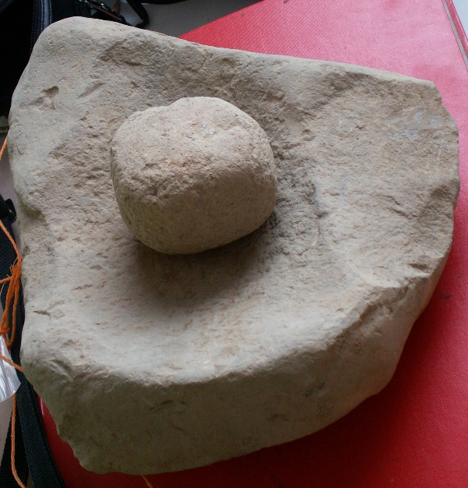
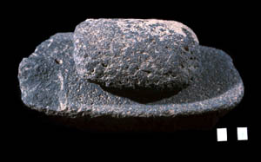
A quern – for grinding grain

Slide 32
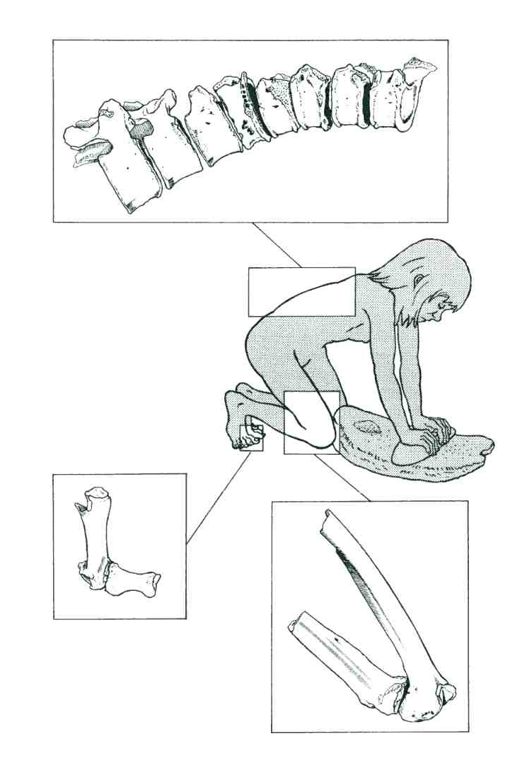
Tell Abu Hureyra – the story from the human bones
Moore et al (2005) – Figure 11.8. The areas of the skeleton that are most affected by injuries associated with the use of the saddle quern.

Slide 33
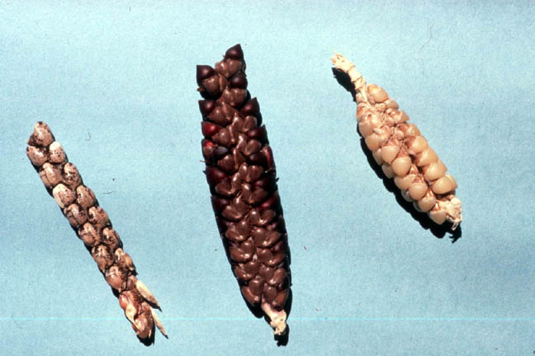
Wild corn/maize
Ancestors of corn - teosinte

Slide 34
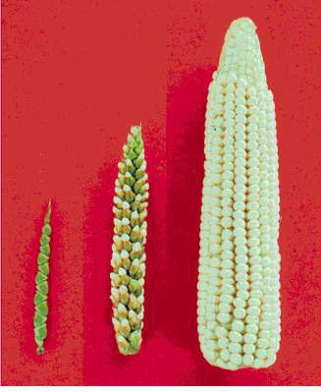
Modern corn (maize) evolved from a grass-like plant called teosinte which underwent selective breeding by the aztecs.
Teosinte (left) can still inerbreed with maize (right) to produce a hybrid.

Slide 35
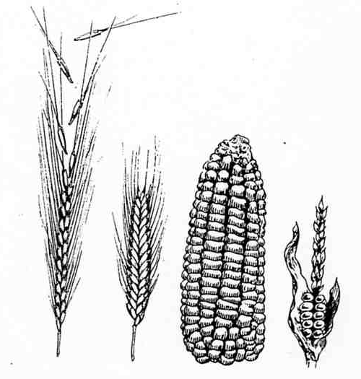
Summary
Domesticated plants have:
Larger seeds
More seeds
Seeds are more firmly attached
Vegetative (asexual) reproduction if possible
Distribution beyond their original area.

Slide 36
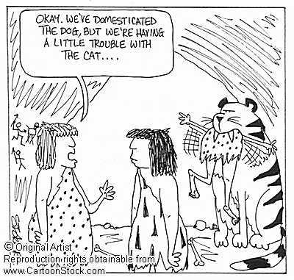
Domestication of animals

Slide 37
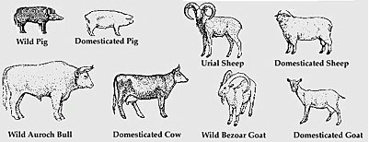
The illustrations above show the effects of domestication on some of the livestock species commonly associated with agriculture in western Asia and Europe.
Domesticated animals are
Smaller
Less aggressive – smaller weapons (horns, tusks)
Better producers of products such as wool or milk

Slide 38
Animal Domestication
Criteria for recognising this include the following:
marked decrease in size from that typical of wild animals or a change in shape of bones from that typical of wild animals to that typical of domestic stock;
the species is found outside its known natural distribution;
a change in the “species spectrum for a site, from a considerable variety of predominantly wild species to relatively few species most of which are now domestic;
changes in the age structure of the killed animals;
changes in the sex ratios of the killed animals

Slide 39
Animal | Where Domesticated | Date
Dog | East Asia | 13,000 BC
Sheep | Western Asia | 8500 BC
Cat | Fertile Crescent | 8500 BC
Goats | Western Asia | 8000 BC
Pigs | Western Asia | 7000 BC
Cattle | Eastern Sahara | 7000 BC
Guinea pig | Peru | 6000 BC
Chicken | Thailand | 6000 BC
Horse | Kazakhstan | 3600 BC
Silkworm | China | 3500 BC
Llama | Peru | 3500 BC
Ass | Egypt | 3000 BC
Bactrian camel | Southern Russia | 3000 BC
Dromedary camel | Saudi Arabia | 3000 BC
Honey Bee | Egypt | 3000 BC

Slide 40
Disadvantages of agriculture
Increase of spreading of disease
Less varied diet – deficiencies
Monoculture increases danger of crop failure
Danger of pests and rot affecting stored crops

Slide 41
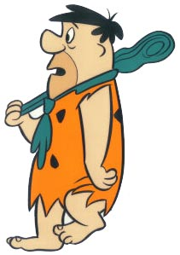
Agricultural Revolution - Domestication

